Slide 1
(Applying machine learning to data sets from shear laboratory experiments, with the goal of identifying hidden signals that precede earthquakes and to determine the accuracy using ML Algorithms to Realtime Dataset.)
B. Tech ECE FINAL YEAR PROJECT -SECOND REVIEW
Earthquake Prediction using Machine Learning
Presentation by: Hrithik Sarda – 17BEC0078 S Srinibha – 17BEC0926
Guide/Mentor: Dr. Renuga Devi S (Associate Professor Sr.) (Dept. of Communication Engineering)

Slide 2
Presentation Outline
Introduction
Laboratory Setup
Challenges present in Earthquake Prediction
Dataset Overview
Objective
Literature Review
Methodology
Results and Discussion
Conclusion
References

Slide 3
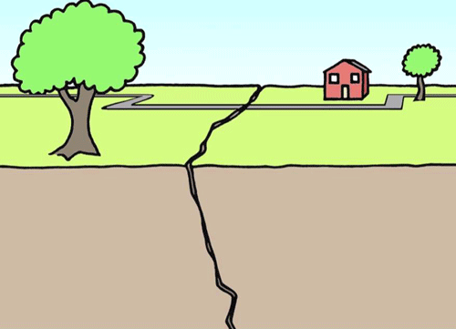
What is an Earthquake?
An earthquake is caused by a sudden slip on a fault.
The tectonic plates are always slowly moving, but they get stuck at their edges due to friction.
When the stress on the edge overcomes the friction, there is an earthquake that releases energy in waves that travel through the earth's crust

Slide 4
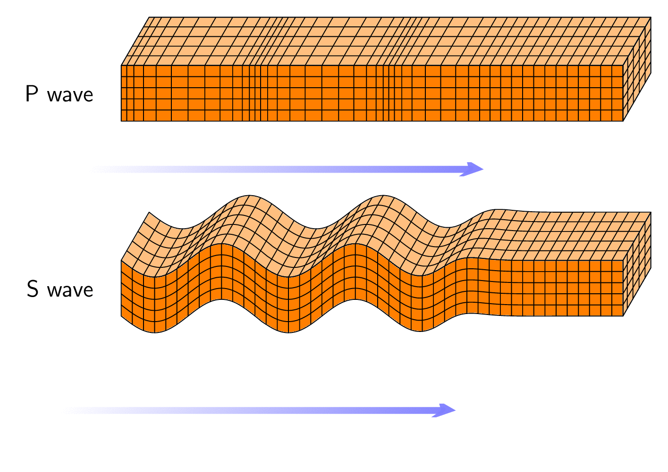
Learning a little bit more….
Earthquake waves are typically composed of different types:
P-waves (compressional waves) -travel faster and do less damage, whereas
S-waves (translational waves)- will land a few seconds later but will do the bulk of the damage.
So now we know which of the two waves we have to worry about-[S waves]

Slide 5
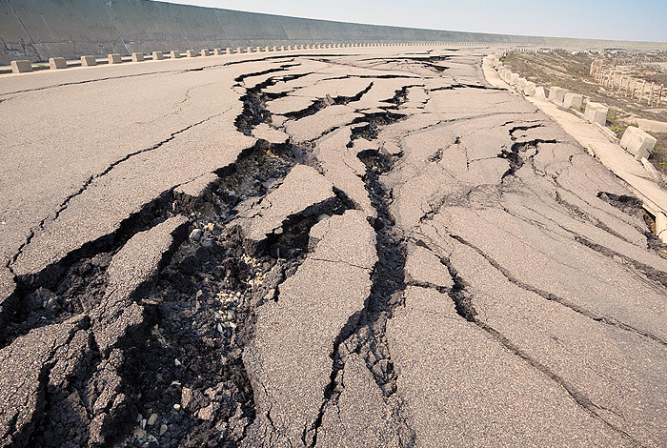
Statistics about Earthquake
The largest recorded earthquake in the world was a
magnitude 9.5 (Mw) in Chile on May 22, 1960.
The earliest reported earthquake in California was felt
in 1769 by the exploring expedition of Gaspar de Portola
while the group was camping about 48 kilometers (30 miles)
southeast of Los Angeles.
The world’s deadliest recorded earthquake occurred in
1556 in central China. It struck a region where most people
lived in caves carved from soft rock. These dwellings collapsed during the earthquake, killing an estimated
830,000 people. In 1976 another deadly earthquake struck in Tangshan, China, where more than 250,000
people were killed.

Slide 6
Introduction
Instead of shooting for the moon and trying to predict earthquakes hours or days in advance, what if we were only looking for a few seconds or minutes of warning?
Many modern power systems have fail safes in place that try to mitigate earthquake damage.
There are modern broadcasting stations which are capable of spreading the information to large distances within seconds.
Up to an extent, people can now take necessary steps to protect themselves from this natural crisis.
This will not only limit structural damage but also save lives more effectively.

Slide 7
Introduction to Approach
Our ideal approach to determining that an earthquake may be looming is based on the interevent time (recurrence interval) for characteristic earthquakes, earthquakes that repeat periodically.
From the well known Parkfield prediction , it is clear that earthquake recurrence is not constant for a given fault, event occurrence can only be inferred within large error bounds.
Over the last 15 years, there has been renewed hope that progress can be made regarding forecasting owing to tremendous advances in computer science these error bounds can be minimized to a minimum.
To this, we suggest that many Machine Learning Regression Models can be implemented and an Early warning system can be created.
Our Earthquake forecasting studies focus on three key points:
1)When will the earthquake occur 2)Where will it occur and?
3) How big will the earthquake be?

Slide 8
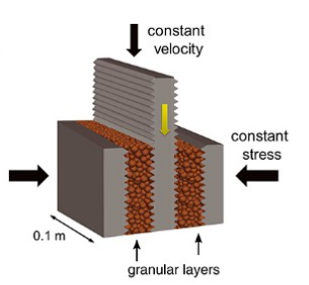
Laboratory Setup
Los Almos National Laboratory successfully generated a laboratory Earthquake and made their research data public on Kaggle.
The basic laboratory setup has two hydraulic presses applying pressure on a vertical plate that is continuously being moved down.
This apparently is a pretty good simulation of the tectonic plate movement near a fault line.
Also, this setup produces earthquakes(or fault failures) at a relatively consistent rate

Slide 9
Challenges present in Earthquake Prediction
There were several challenges present in Earthquake Prediction.
Gathering Real time data from a regional or global network of monitoring stations.
Large Data.
Computing time .
Feature Extraction.
No existing method for precursor monitoring.
Understanding the behavior of the earthquake source.

Slide 10
Datasets Overview
We used 2 different datasets. In Dataset – I, in the laboratory, researchers at Los Alamos National Laboratory imitated a real earthquake
Dataset – II is real-time data taken from the following USGS website,
https://earthquake.usgs.gov/
For Dataset-II ,Himalayan Plateau region was considered. 5978 earthquakes that occurred between 26th February, 1950 and 26th December 2020.

Slide 11
Dataset Overview
Parameter | Dataset – I | Dataset – II
Data | Acoustic Data vs Time to Failure | Earthquakes occurred near the Himalayan Plateau.
Area of Study | Los Almos National Laboratory | Himalayan Plateau
Years of Study | 2017 | 26/02/1950- 26/12/2020
Courtesy | Online Website www.kaggle.com | Online Website https://earthquake.usgs.gov/
Forecast Frequency | Sample frequency – 4MHz Sample\Experiment time – 153.6 s | Daily

Slide 12
Objective
Visualize and locate the affected areas due to earthquake worldwide using python and data collected from USGS website.
Acoustic properties of seismic signals underneath the surface of an Earthquake prone area were used to predict the Time to Failure in seconds.
Geographical properties of the area and data from past earthquake incidents was used to predict the Depth and Magnitude of the upcoming earthquakes.

Slide 13
Literature Review
Title | Author | Objective | Methodology | GAP | Link
Artificial neural network based estimation of moment magnitude with relevance to Earthquake Early Warning | Ajit Kundu, Y. S. Bhaduria, S. Basu, S. Mukhopadhyay | An Artificial Neural Network (ANN) based algorithm for rapid estimation of seismic moment magnitude (Mw) for Earthquake Early Warning (EEW) is proposed in the paper. | The amplitude spectrum computed in the frequency range between 0.0098 and 10 Hz from the vertical component of seismograms recorded by a single 3–component station have been considered as inputs to the ANN and Mw as desired output. The trained ANN has been found to estimate Mw of about 73% of the new events with absolute error less than 0.1 and of 100% of the events with absolute error less than 0.35 | An ANN based direct mapping algorithm is proposed for rapid estimation of Mw of earthquakes using only vertical component recording of a single 3-component station at regional distance from the earthquake source. | https://ieeexplore.ieee.org/document/8300102/metrics#metrics
Predictability of repeating earthquakes near Parkfield, California | Zechar, J. D., & Nadeau, R. M. | This paper analyses sequences of repeating microearthquakes that were identified by applying waveform coherency methods to data from the Parkfield High-Resolution Seismic Network. | Authors applied three variants of a simple algorithm on datasets that produces sequence-specific, time-varying hazard functions, and they found that these sequences are predictable. This gave us an intuition that a forecast of intermediate to large earthquakes based on the spatial distribution of small earthquakes has substantial predictive skill . We know it is not obvious how to transfer knowledge gained from studies of small earthquakes to applications of large earthquake forecasting, This is where Machine Learning comes in . Authors deployed several functional forms have been proposed to model interevent times; we considered exponential, log-normal, Weibull and inverse Gaussian distributions as there is no strong evidence to favour any one functional form. | This would suggest that the exact details of repeat identification are not particularly important, and it reinforces the idea that learning something about the occurrence of small earthquakes can improve our understanding of the occurrence of large earthquakes. When simple hazard functions and probability distributions are able to predict the recurrent time, It would become a lot easier for ML models to identify the relation between data. | https://www.researchgate.net/publication/258646360_Predictability_of_repeating_earthquakes_near_Parkfield_California

Slide 14
Literature Review
Title | Author | Objective | Methodology | GAP | Link
Random Forests | Leo breiman | A brief discussion on Random Forest Algorithm. | Random forests are a combination of tree predictors such that each tree depends on the values of a random vector sampled independently and with the same distribution for all trees in the forest. The generalization error for forests converges a.s. to a limit as the number of trees in the forest becomes large. The generalization error of a forest of tree classifiers depends on the strength of the individual trees in the forest and the correlation between them. Random forests for regression are formed by growing trees depending on a random vector such that the tree predictor takes on numerical values as opposed to class labels. The output values are numerical and we assume that the training set is independently drawn from the distribution of the random vector Y, X. The random forest predictor is formed by taking the average over k of the trees. Because of the Law of Large Numbers they do not overfit. Injecting the right kind of randomness makes them accurate classifiers and regressors. Furthermore, the framework in terms of strength of the individual predictors and their correlations gives insight into the ability of the random forest to predict. | Random forests are an effective tool in prediction. Because of the Law of Large Numbers they do not overfit. Injecting the right kind of randomness makes them accurate classifiers and regressors. Furthermore, the framework in terms of strength of the individual predictors and their correlations gives insight into the ability of the random forest to predict. Using out-of-bag estimation makes concrete the otherwise theoretical values of strength and correlation | https://link.springer.com/article/10.1023/A:1010933404324
The challenges and possibilities of earthquake predictions using non-seismic precursors | A. Bhardwaj, L. Sam & F. J. Martin-Torres |  |  |  | https://link.springer.com/article/10.1140/epjst/e2020-000257-3

Slide 15
Literature Review
Title | Author | Objective | Methodology | GAP | Link
Large earthquake occurrence estimation based on radial basis function neural networks | Alexandridis, A., Chondrodima, E., Efthimiou, E., Papadakis, G., Vallianatos, F., & Triantis, D | This paper introduces a new methodology to estimate the occurrence of significant earthquake events based on RBF NNs, given a database of historic seismicity data. The input vector to the network is composed of different seismicity rates between main events , which are easy to calculate in a reliable manner whereas the output variable is the interevent time between significant seismic events. Training of the NNs is performed using the powerful fuzzy means training algorithm, this helps the algorithm to account for the limited number of training data. | Training of the RBF models is performed using a novel variant of the FM algorithm, which applies LOO-CVin order to deal successfully with small data sets, while maintaining the advantages of the original FM algorithm, which include higher accuracy of the produced networks compared with other approaches.Additionally, the proposed training algorithm is combined with the Reasenberg clustering technique, which is used to remove aftershock events from the catalog prior to processing the data with the NN. | The results stress the importance of removing the aftershock events since a reliable estimation cannot be obtained using the raw catalog. To this end, the Reasenberg technique is employed in order to decluster the raw catalog. . | https://doi.org/10.1109/TGRS.2013.2288979
Acoustic emissions document stress changes over many seismic cycles in stick-slip experiments | Goebel, T. H. W., Schorlemmer, D., Becker, T. W., Dresen, G., & Sammis, C. G. | This paper reports on the connection between stress and microseismic event statistics prior to the possibly smallest earthquakes: those generated in the laboratory. Authors investigate variations in seismic b value of acoustic emission events during the stress buildup and release on laboratory-created fault zones. This experiment shows how that b values mirror periodic stress changes that occur during series of stick-slip events, and are correlated with stress over many seismic cycles. | Loading conditions and sample geometry were chosen in such a way that they represent natural faulting conditions as closely as possible. Four triaxial experiments (W4, W5, W7, and W8), conducted on cylindrical (radius = 2 cm, height = 10.7 cm) specimens at constant loading rates at GFZ-Potsdam, Germany. All experiments were performed on oven-dried samples at room temperatures. We introduced 1.5–2.5 cm deep saw cut notches at a 30° angle to the loading axis to localize faulting at the center of the specimens during initial fracture and subsequent stick-slip sliding. The results presented here are from the stick-slip sliding stage of previously fractured specimens. Our initial condition, i.e., an incipient fracture surface that develops into a fault zone, can be seen as an analog for the structural complexity of natural fault zones. To monitor microcrack formation and sample deformation, strain gauges and AE sensors were glued to the specimen surface | It was observed that b values vary significantly within a seismic cycle in stick-slip experiments and that the amount of increase in b after a slip event is related to the stress drop . Our results suggest that the magnitude of increase in b value after failure can be associated with the effectiveness of a large earthquake to release stored shear stress on a fault | https://doi.org/10.1002/grl.50507

Slide 16
Methodology

Slide 17
 | Dataset 1 (Laboratory data) | Dataset 2 (Real-time data)
Data Pre-processing | • Missing values are filled with mean •Datatype conversions to save computing power • Standard Feature Scaling | • Missing values are filled with mean • Removing time and region columns
Feature Extraction | •Mean •RMS •Standard deviation •Peak •Mean of absolute value • Skewness • Kurtosis •Crest Factor •Log-log ratio | • Latitude • Longitude • Depth • Magnitude
ML Algorithms | • Random forest regressor • Support Vector Machine • Kernel Ridge Regression • Catboost Regressor | • Random forest regressor • Support Vector Machine • Decision Tree
Result Visualisation | • Plotting predicted value vs actual value for all the algorithms. • Comparing the Machine learning models by plotting their output waveforms with the original waveforms. | • Visualising Earthquakes occurred between 7-11-2020 – 31-12-2020. • Comparing the Machine learning models by scattering predicted outputs vs actual values.

Slide 18
Data Preprocessing:
In Machine Learning processes, data preprocessing is critical to encode the dataset in a form that could be interpreted and parsed by the algorithm.
For Dataset – I, we first fill in the missing values with mean of all the values present in that particular column. We execute Datatype conversion to save computing power and then apply Standard Feature Scaling on the dataset.
Dataset – I , Total observations in the dataset were 62,92,50,000 . To reduce computational complexity, bins consisting of chunks of data were created . Each bin(input) is a chunk of 0.0375 seconds of seismic data (ordered in time), which is registered at 4 MHz, thus 150,000 data points. This gives 4096 bins .i.e. 4096 data points.
For Dataset – II, we again fill in the missing values with mean of all the values present in that particular column. We remove the unnecessary columns such as, Time and Region. Splitting of data into test and train was performed resulting in, training dataset containing 4780 values and testing dataset containg 1196 values .

Slide 19
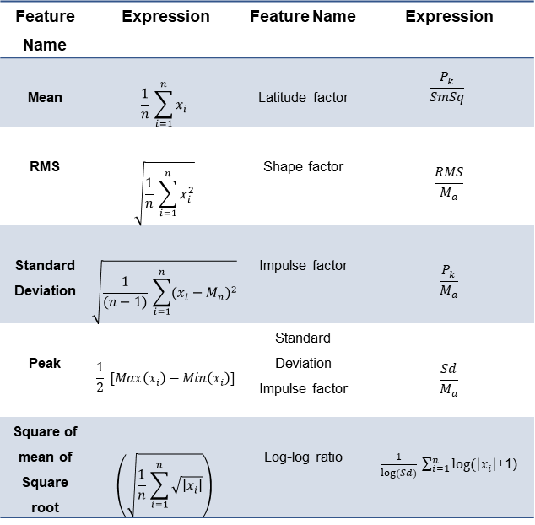
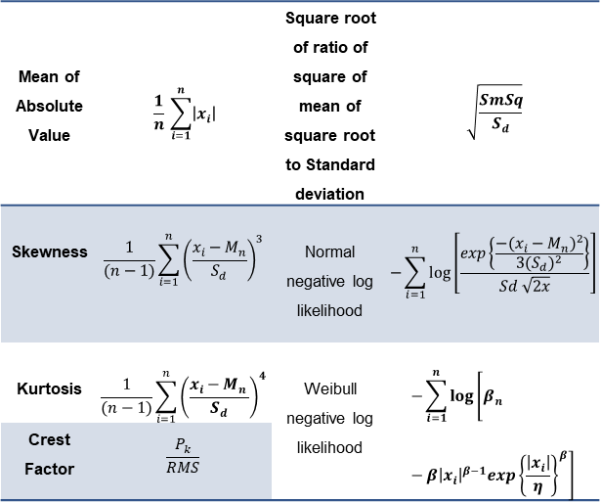
Feature extraction for Dataset-I
Feature extraction is the name for methods that select and /or combine variables into features, effectively reducing the amount of data that must be processed, while still accurately and completely describing the original data set
Feature Name | Expression | Feature Name | Expression
Mean | $$\frac{1}{n} \sum_{i=1}^{n}{x_{i}}$$ | Latitude factor | $$\frac{P_{k}}{SmSq}$$
RMS | $$\sqrt{\frac{1}{n} \sum_{i=1}^{n}{x_{i}^{2}}}$$ | Shape factor | $$\frac{RMS}{M_{a}}$$
Standard Deviation | $$\sqrt{\frac{1}{(n−1)} \sum_{i=1}^{n}{{(x_{i}−M_{n})}^{2}}}$$ | Impulse factor | $$\frac{P_{k}}{M_{a}}$$
Peak | $$\frac{1}{2} [Max\left(x_{i}\right)−Min\left(x_{i}\right)]$$ | Standard Deviation Impulse factor | $$\frac{Sd}{M_{a}}$$
Square of mean of Square root | $$\left(\sqrt{\frac{1}{n} \sum_{i=1}^{n}{\sqrt{\left|x_{i}\right|}}}\right)$$ | Log-log ratio | $\frac{1}{log⁡(Sd)} \sum_{i=1}^{n}{log⁡(\left|x_{i}\right|}$+1)
Mean of Absolute Value | $$\frac{1}{n} \sum_{i=1}^{n}{\left|x_{i}\right|}$$ | Square root of ratio of square of mean of square root to Standard deviation | $$\sqrt{\frac{SmSq}{S_{d}}}$$
Skewness | $$\frac{1}{(n−1)}\sum_{i=1}^{n}{{\left(\frac{x_{i}−M_{n}}{S_{d}}\right)}^{3}}$$ | Normal negative log likelihood | $$−\sum_{i=1}^{n}{log⁡\left[\frac{exp\left\{\frac{{{−(x}_{i}−M_{n})}^{2}}{3{(S_{d})}^{2}}\right\}}{Sd \sqrt{2x}}\right]}$$
Kurtosis | $$\frac{1}{(n−1)}\sum_{i=1}^{n}{{\left(\frac{x_{i}−M_{n }}{S_{d}}\right)}^{4}}$$ | Weibull negative log likelihood | $$−\sum_{i=1}^{n}{log⁡\left[β_{n}−β{\left|x_{i}\right|}^{β−1}exp{\left\{\frac{\left|x_{i}\right|}{η}\right\}}^{β}\right]}$$
Crest Factor | $$\frac{P_{k}}{RMS}$$

Slide 20
Machine Learning Algorithms used for Dataset-I
Random Forest Algorithm
This is a supervised machine learning algorithm which can be used for both classification and Regression.
The "forest" it builds, is an ensemble of decision trees, usually trained with the “bagging” method. The general idea of the bagging method is that a combination of learning models increases the overall result.
Kernel Ridge
This is a supervised machine learning algorithm which can be used for both classification and Regression.
This is a supervised machine learning algorithm which can be used for both classification and Regression.
In the SVM algorithm, we plot each data item as a point in n-dimensional space (where n is number of features you have) with the value of each feature being the value of a particular coordinate. Then, we perform classification by finding the hyper-plane that differentiates the two classes very well
Kernel ridge regression (KRR) combines ridge regression (linear least squares with l2-norm regularization) with the kernel trick. It thus learns a linear function in the space induced by the respective kernel and the data.
This is also known as Least Squares Support Vector Machine
Support Vector Machine

Slide 21
Machine Learning Algorithms used for Dataset-II
Random Forest Algorithm
This is a supervised machine learning algorithm which can be used for both classification and Regression.
The "forest" it builds, is an ensemble of decision trees, usually trained with the “bagging” method. The general idea of the bagging method is that a combination of learning models increases the overall result.
Decision Tree
This is a supervised machine learning algorithm which can be used for both classification and Regression.
The goal of using a Decision Tree is to create a training model that can use to predict the class or value of the target variable by learning simple decision rules inferred from prior data (training data).
Support Vector Machine
This is a supervised machine learning algorithm which can be used for both classification and Regression.
In the SVM algorithm, we plot each data item as a point in n-dimensional space (where n is number of features you have) with the value of each feature being the value of a particular coordinate. Then, we perform classification by finding the hyper-plane that differentiates the two classes very well

Slide 22
RESULTS AND DISCUSSION

Slide 23
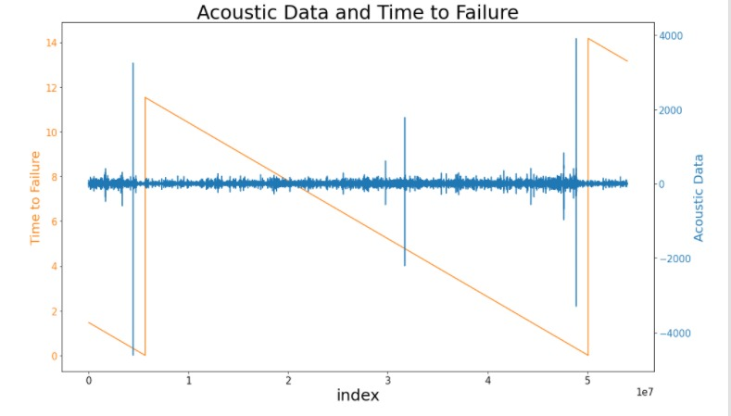
Results of Dataset -I
Figure 1 – Acoustic Data and Time to Failure: 1% Sampled Data (Dataset – I)

Slide 24
Explanation for figure 1:
The graph shows 1% of evenly sampled data from a dataset containing approximately 5,00,00,000 entries.
It was observed that right before the Earthquake. i.e., Vertical blue line (TTF tends to 0) there is a spike in seismic activities. the red line.
The dataset contained approximately 65,00,00,000 rows/data-points.
Due to lack of computation power, we were able to visualize only a window of dataset at a time. After plotting all the windows, a pattern was observed. A spike in seismic activity was followed by a large quake.
This is the result of Exploratory Data Analysis (EDA). Following this result were many follow up questions like, Is the interval constant? or are any other factors affecting this pattern?
Machine learning models will help us understand these patterns more deeply and generate a pattern that will help us predict Earthquakes.

Slide 25
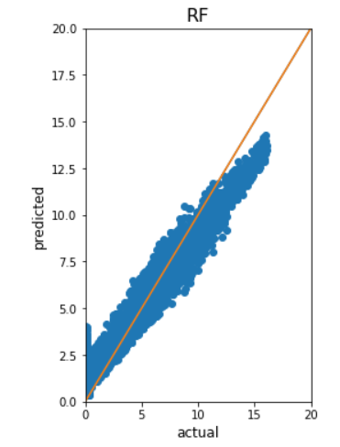
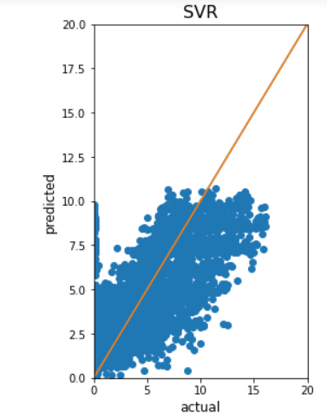
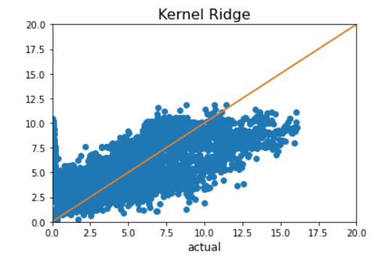
Results of Dataset -I
Figure 2 : Result Visualization of ML Algorithms used for Dataset – I
[Acoustic data vs Time to Failure]: Actual values vs Predicted values

Slide 26
Explanation for figure 2:
These graphs show performance of Random Forest, Support Vector and Kernel Ridge Regression with respect to the actual values.
Limits of X and Y axis were set according to the range of time to failure which ranges between 0 and 20.
Plots clearly state that Random Forest performed the best amongst the three. It is difficult to make out from the plots which one of KR and SVR performed better. RF beats all the three with significant margin.
Therefore, with the help of performance metric R-Squared we can say that Kernel Ridge performed a little better than SVR.

Slide 27
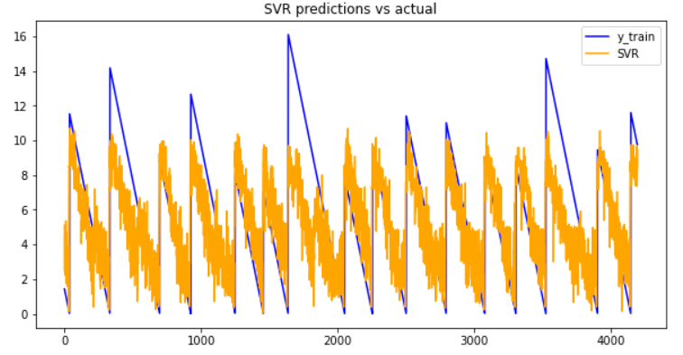
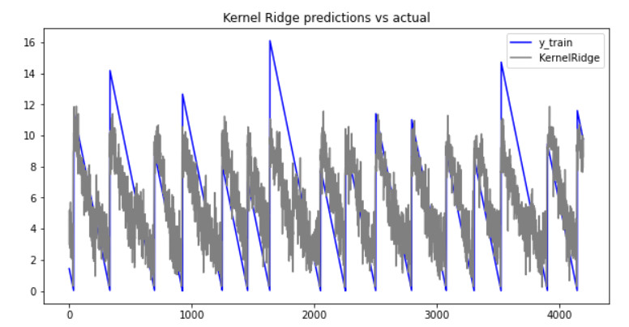
Results of Dataset -I

Slide 28
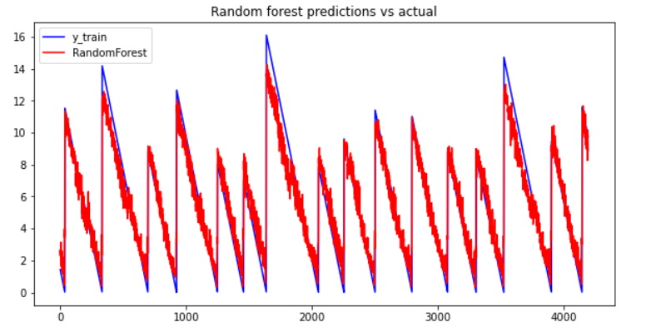
Results of Dataset -I
Figure 3 –Waveform Visualization of actual waveform and predicted waveform for Dataset – I , [ SVR , KR , RF].

Slide 29
Explanation for Figure 3:
Dataset-I contained approximately 65,00,00,000 observations.
Split original dataset containing 6500 million rows into 4096 data frames each containing 150000 rows.
Single observation of X [Independent variable vector] and Y [Dependent Variable Vector] is created by taking the mean of all columns in each data frame. Therefore, both X and Y will contain 4096 rows.
X data frame 13 columns [Mean, Median, skewness etc.] and 4195 rows and Y data frame contains 1 column [Time to failure] and 4195 rows.
After applying Machine Learning algorithms on these generated X and Y, we get an output vector containing predicted time to failure values. Plotting actual vs predicted values for each algorithm we get the waveforms above.
Waveforms confirm that Random Forest is relatively the best performer followed by Kernel Ridge and then Support Vector Regression.

Slide 30
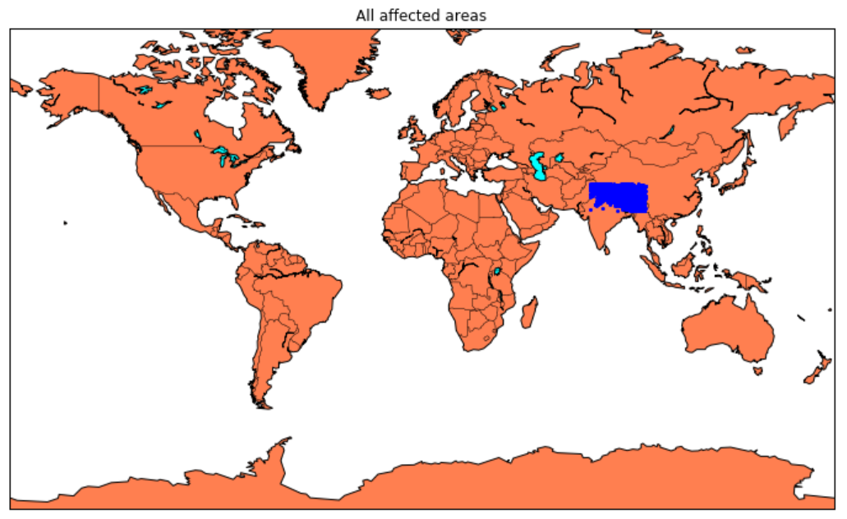
Results of Dataset -II
Figure 4– Earthquake affected areas using Dataset – II

Slide 31
Explanation for Figure 4:
Below blue spots on the World map indicates the areas affected extracted from Dataset – II.
This map shows latest Earthquakes at the Himalayan Plateau
Dataset – II is collected from, https://earthquake.usgs.gov/, a government website where all the past Earthquakes are cataloged systematically.
Dataset contains Latitude and Longitude of the region and hence we can locate the exact location on the world map
It is possible to find out the location of the affected regions on the world map by changing the Dataset. They will be represented by blue dots as shown in the figure above.

Slide 32
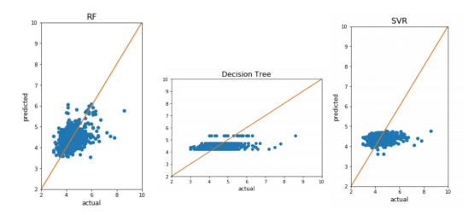
Results of Dataset -II
Figure 5 – Result Visualization of ML Algorithms used for Dataset – II

Slide 33
Explanation for Figure 5:
These graphs show performance of Random Forest, Support Vector and Decision Tree Regression with respect to the actual values.
Limits of X and Y axis were set according to the range of time to failure which ranges between 2 and 10. 45
Plots clearly state that Random Forest performed the best amongst the three. It is difficult to make out from the plots which one of DT and SVR performed better. RF beats all the three with significant margin.
Therefore, with the help of performance metric R-Squared we can say Decision Tree performed a little better than SVR.
The orange diagonal in each plot represents center of distribution. For RF the variance in the distribution is very less. It is as if almost all the predicted values overlap actual values.

Slide 34
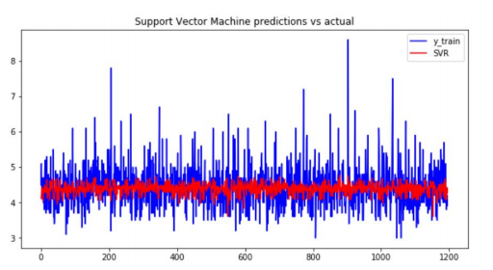
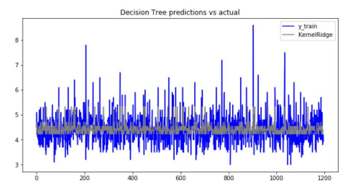
Results of Dataset -II

Slide 35
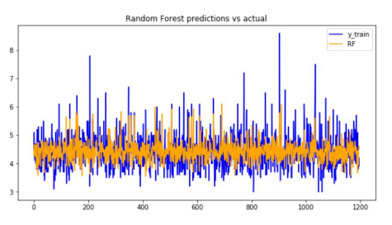
Results of Dataset -II
Figure 5 –Waveform Visualization of actual waveform and predicted waveform for Dataset – II

Slide 36
Explanation for Figure 6:
Dataset - II contained approximately 5976 observations.
Using pandas in python we were able to split our original dataset 4780 and 1196.
X data frame 3 columns [Latitude, Longitude and Depth] and Y data frame contains 1 column [Magnitude].
After applying Machine Learning algorithms on these generated X and Y, we plotted actual vs predicted values for each algorithm we get the waveforms above.
Waveforms confirm that Random Forest is relatively the best performer followed by Decision Tree and then Support Vector Regression.

Slide 37
OVERALL RESULT AND PERFORMANCE OF EACH ML ALGORITHM:
ML Algorithms | MAE |  | RMSE |  | R- Squared
Dataset | 1 | 2 | 1 | 2 | 1 | 2
SVM | 2.09421 | 0.4276 | 2.76348 | 0.5612 | 0.43386 | 0.0374
RF Algorithm | 0.80280 | 0.4162 | 1.03247 | 0.5561 | 0.92097 | 0.1374
Kernel Ridge | 2.10980 | --- | 2.71360 | --- | 0.45412 | ---
Catboost | 3.21763 | --- | 3.82865 | --- | 0.0866 | ---
DT | --- | 0.4276 | --- | 0.5612 | --- | 0.1215

Slide 38
Table Contents and Description:
MAE: Mean absolute error refers to the magnitude of difference between the prediction of an observation and the true value of that observation. MAE takes the average of absolute errors for a group of predictions and observations as a measurement of the magnitude of errors for the entire group. MAE can also be referred as loss function.
RMSE: It is calculated as the square root of the mean of the squared differences between actual outcomes and predictions. Squaring each error forces, the values to be positive, and the square root of the mean squared error returns the error metric back to the original units for comparison.
R- Squared: RMSE is calculated as the square root of the mean of the squared differences between actual outcomes and predictions. Squaring each error forces, the values to be positive, and the square root of the mean squared error returns the error metric back to the original units for comparison.
The above table clearly states that Random Forest Algorithm is the best performing algorithm for both Dataset – I and Dataset – II.

Slide 39
Conclusion
Stastical Analysis : Random Forest regression performed the best on both the Datasets. In both the cases it had an R-Squared value of 0.92 and 0.97. SVR, Kernel Ridge, Catboost Regressor and Decision tree Regression performed poorly with R-Squared values around 0.45. Other than R-Squared, RMSE and MAE also pointed towards Random Forest being the best Regression Model. Plots of actual values vs predicted values show the variance generated by each model.
To summarize, we show that ML applied to this experiment provides accurate failure forecasts based on the instantaneous analysis of the acoustic signal at any time in the slip cycle and reveals a signal previously unidentified.
Our current approach is to progressively scale from the laboratory to the Earth by applying this approach to Earth problems that most resemble the laboratory
Also, to predict the ML Algorithms with highest accuracy on real time data. Thus, the stage has been set for potentially marked advances in earthquake science.

Slide 40
Future Work:
With advancement in technology, it is expected of data scientists to come up with more robust methods of predicting earthquakes with higher certainty.
However, in addition to the pre-earthquake and post-earthquake alleviation actions, studies in the recent decades have reported several possible earthquake precursors such as anomalies in electric field, magnetic field, gas/aerosol emissions, ionospheric signals, ground water level, land surface temperature, surface deformations, animal behavior, thermal infrared signals, atmospheric gravity waves, and lightning.
Such substantial number of scientific articles and reported anomalous signals should not be overlooked. Understanding the relation between time of occurrence of these precursors can give us a strong hold on minimizing the chaos that an Earthquake can create.
A general 50 point of concern is the widely varying arrival times and the amplitudes of the anomalies, putting a question mark on their universal applicability as earthquake markers.
In future, the need to standardize the precursor detection techniques and to employ a global-scale monitoring system for making any possible earthquake predictions reliable.

Slide 41
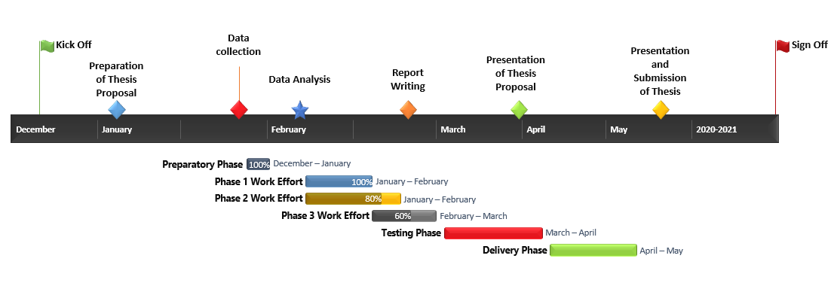
Gantt Chart

Slide 42
Working Timeline
January : Deciding on the domain of the project .i.e. Machine learning . Choosing a project that is achievable yet has significant importance on the society . Deciding the topic, “ Earthquake Prediction Using ML”.
February: Liable Data Source ,Data Collection, Data Cleaning and Exploratory Data Analysis.
March : Choosing programming language. Completing the Data preprocessing phase and making the dataset ready for implementation . Feature extraction was almost done by the end of the month,
April : Studying and short-listing from a list of Supervised ML algorithms . Calculating Performance metrics of regression algorithms. These metrics include MAE, RMSE and R-Squared.
May : Optimizing results based by choosing the best hyper parameters. Implementing Grid-Search CV in required algorithms . Result visualization using matplotlib library. Writing thesis , Creating poster and Completing PPT.
June : Finishing off on presentation and Thesis. Final presentation on 5th June,2021.

Slide 43
References
Ajit Kundu, Y. S. Bhaduria, S. Basu, S. Mukhopadhyay, “Artificial neural network-based estimation of moment magnitude with relevance to Earthquake Early Warning”, International Conference on Wireless Communications, 2017.
Yih-Min Wu, Li Zhao, “Magnitude estimation using the first three seconds P-wave amplitude in earthquake early warning”, Geophysical Research Letters, August,2006.
Yih-Min Wu, Hiroo Kanamori, Richard M. Allen, Egill Hauksson, “Determination of earthquake early warning parameters, τ c and Pd, for southern California”, The Authors Journal Compilation, 2007.
Kemal Gunaydin, Ayten Gunaydin, “Peak Ground Acceleration Prediction by Artificial Neural Networks for Northwestern Turkey”, 2008.
Jasperson H.A, Bolton D.C, Johnson P.A, Marone C, Dehoop M, “Toward laboratory earthquake prediction using unsupervised classification of acoustic emissions”, American Geophysical Union, December, 2018.
F Corbi, L Sandri, J Bedford, F Funiciello, S Brizzi, M Rossenau, S Lallemand, “Machine Learning Can Predict the Timing and Size of Analog Earthquakes”, American Geophysical Union, February, 2019.
Lixiao Gong, Qiang Li, Jingfa Zhang, “Earthquake building damage detection with object-oriented change detection”, IEEE International Geoscience and Remote Sensing Symposium - IGARSS, 2013.
Yanmei Zhang, Zaisen Jiang, Ying Fang, Haiying Huang, Xiao Cheng, “Thermal anomaly detection for 2014 Jinggu earthquake using remote sensing data”, IEEE International Geoscience and Remote Sensing Symposium - IGARSS, 2015.
Hu Ye, “Life Detection Technique in Earthquake Search and Rescue”, Second International Conference on Instrumentation, Measurement, Computer, Communication and Control, 2012.

